Slide 1

Notes:
Thank you for coming. I know most or all of you support arts and culture nonprofits in Oregon. I want you to know about a way to DOUBLE the impact of your donation FOR FREE. It’s what we call “doubling the love” through the Oregon Cultural Trust’s Cultural Tax Credit.
First, lets talk about “Culture” in our state.
It can be one of those know-it-when-you--experience-it things, right?

Slide 2

Notes:
Certainly, we might think we’re all in agreement on what it is… the ballet. Art museum. Opera, Symphony, of course. Literature. Each one of those is commonly associated with “Culture” (in quotes.) Everyone can agree on that.

Slide 3

Notes:
In fact in our state, we are blessed with a bounty of experiences that fall under the cultural umbrella: arts, heritage, history and humanities. And taken together, this bounty plays an enormous, very (essential) role in making Oregon, Oregon.
But doesn’t culture “just happen?” you ask. For sure, a lot of it was here long before we were. We didn’t create it all. But a lot of our culture can disappear, especially those traditions that aren’t as well known. It can lose its way. It simply can’t be taken for granted that it will thrive forever on its own.
We can make sure our culture—in all its many forms— thrives. That Oregon stays the special place that it is. That our special something continues; that it opens new eyes, continually opens new hearts, and makes new connections for our generation and generations to come

Slide 4
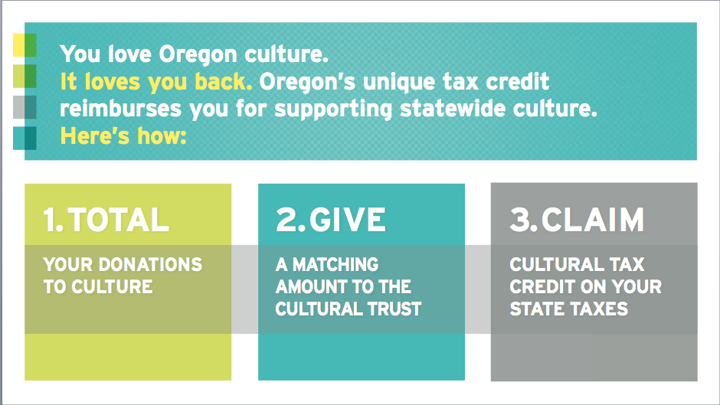
Notes:
I know that you are someone who values Oregon’s culture. That you more than likely give to cultural organizations in the state. Now I want to tell you about how you can double the love you have for Oregon’s culture at no additional cost. It sounds too good to be true, but it’s true. And it has to do with a tax credit that the Oregon legislature set up IN 2002. Here’s how it works:
At the end of the year, TOTAL your donations to any of the 1400+ qualifying cultural non-profits in the state. ** Show list of nonprofits in the county/area**. You will be getting a bookmark to keep track of your donations, too.
GIVE a matching amount to the Oregon Cultural Trust before Dec. 31.
CLAIM the matching Trust donation as a cultural tax credit—the amount you owe-- on your State tax return.
There are limits to the amount you can claim - $500 for individuals, $1000 for couples and $2500 for C-Corps.

Slide 5
MONEY RAISED IN 2016
$4,620,000
Notes:
In 2016, we received over $4.6 million in donations from Oregonians like you. The Trust has over 9,100 donors in the state. But there are 250,000 Oregonians giving to cultural non-profits that could be taking advantage of the tax credit and helping build a fund for culture in the Which is why I wanted to make sure you knew about it!

Slide 6

Notes:
40% of the money donated per year goes into a permanent fund, earning interest, ready for future opportunities. The other 60% supports the five state-wide Cultural Partners, 45 county and tribal coalitions, and over 1,400 nonprofits throughout the state. Pretty remarkable.
This is why the Oregon Cultural Trust exists. To put wind in the sails of all kinds of cultural initiatives, big and small, well-known and lesser-known, all across our state..
Every county and federally recognized tribe in the state receives funds. A committee of people—who know what their community needs and wants-- choose where the money goes. So small groups that don’t have sophisticated grant writers are not overlooked.

Slide 7
FREQUENTLY ASKED QUESTIONS
“THIS IS A WAY TO FURTHER INVEST IN OREGON CULTURE THAT I LOVE, AND IT DOESN’T COST ANYTHING. IS THERE A CATCH?”
Nope. The Trust was set up by the Oregon legislature to provide funding for culture regardless of federal funding priorities. This is the kind of creativity and innovation you’d expect from the state that brought us the bottle bill and public beaches!
“WHY DOESN’T EVERY OREGONIAN DO THIS?”
Most Oregonians don’t know about it, or think it’s too complex – but making a matching gift and claiming it on your tax return is very easy. Some might forget to make their donation before Dec. 31.
“HOW DO I KNOW IF THE ORGANIZATIONS I SUPPORT QUALIFY FOR THE MATCHING GIFT?”
A full list of qualifying nonprofits is on our website. Go to CulturalTrust.org and click on “Get Involved.”
Notes:
Here are some FAQ’s we get…
What other questions do you have?
If asked something you don’t know, document it and send to Aili for clarification. Email the answer to all attendees.

Slide 8
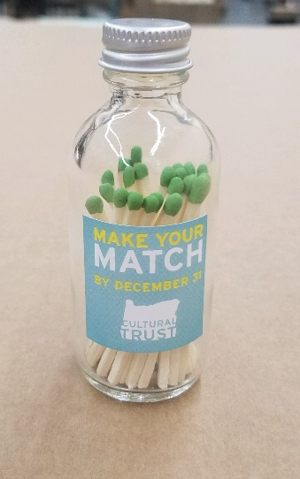
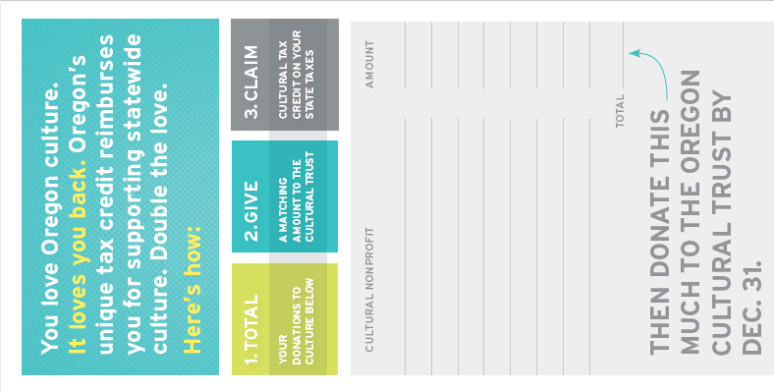
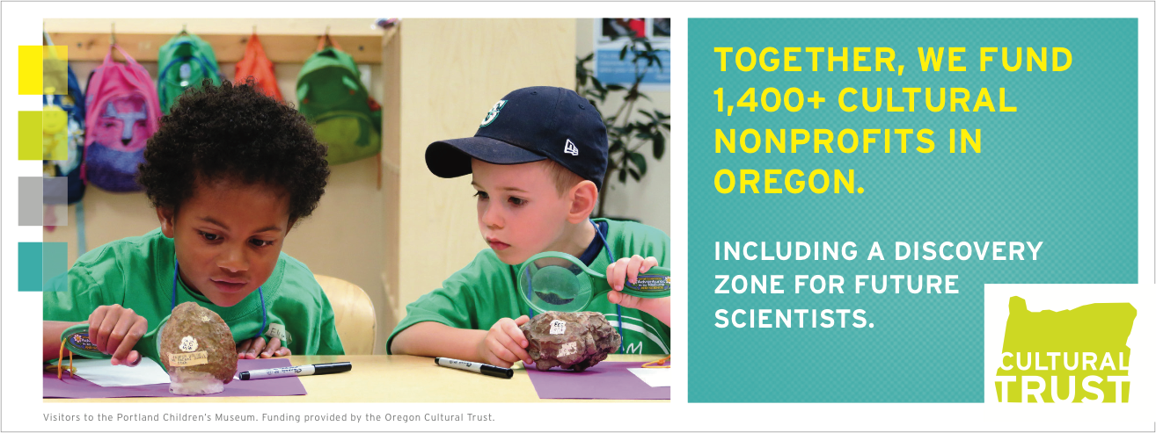
TOOLS TO TAKE HOME
BOOKMARK
Hand these out to friends, family, board members and other cultural supporters to help them total their donations.
MATCHES
Matches for your mantel to remind you to give before Dec. 31.
Notes:
I’m going to send some tools home with you so you remember to make your matching donation.
Bookmark (and a few to hand out!)
Matches – a reminder to make your match!
I will also send a clipboard around to get your contact information so I can email you to remind you to take advantage of the tax credit.

Slide 9
MORE INFORMATION
VISIT CULTURALTRUST.ORG TO LEARN MORE AND DONATE.
THERE, YOU’LL ALSO FIND:
A list of qualifying nonprofits, by county and alphabetically.
A downloadable calendar reminder to give.
Information about projects the Trust funds.
A short video explaining the cultural tax credit.
More questions? Consult your CPA or call the Trust at (503) 986-0088.
Notes:
If you want more information, the website has a number of resources. You can also ask your CPA or tax preparer (educate them if they don’t know about the Trust!) or call the Trust office.

Slide 10
CULTURALTRUST.ORG
Notes:
Thank you!

