Slide 1
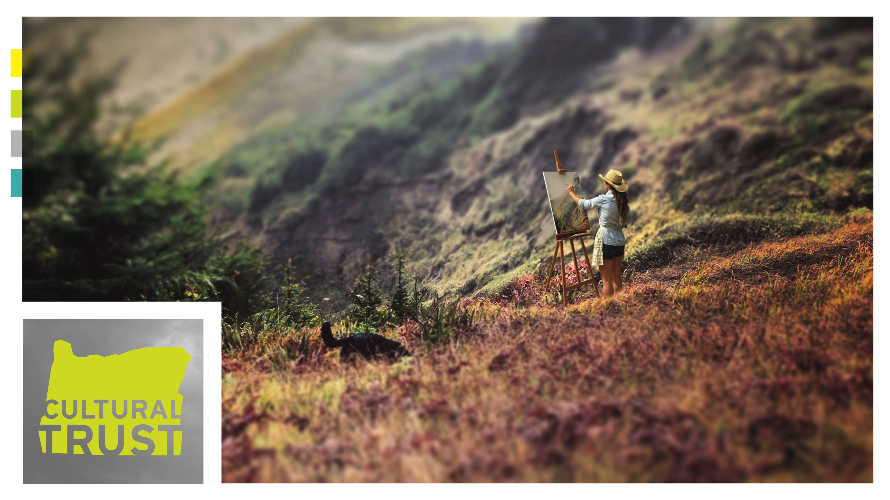
Notes:
“Culture.”
It can be one of those know-it-when-you--experience-it things, right?

Slide 2

Notes:
“Culture.”
It can be one of those know-it-when-you--experience-it things, right?

Slide 3
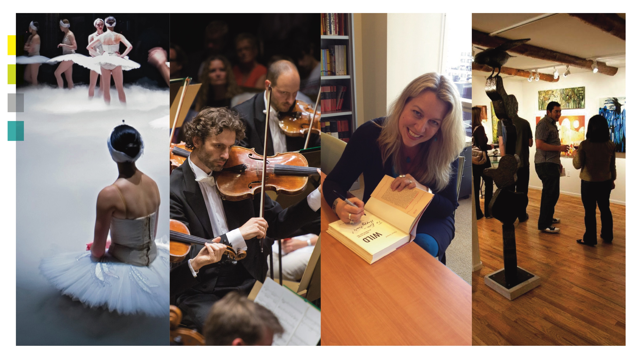
Notes:
Certainly, we might think we’re all in agreement on what it is… the ballet. Art museum. Opera, Symphony, of course. Literature. Each one of those is commonly associated with “Culture” (in quotes.) Everyone can agree on that.

Slide 4
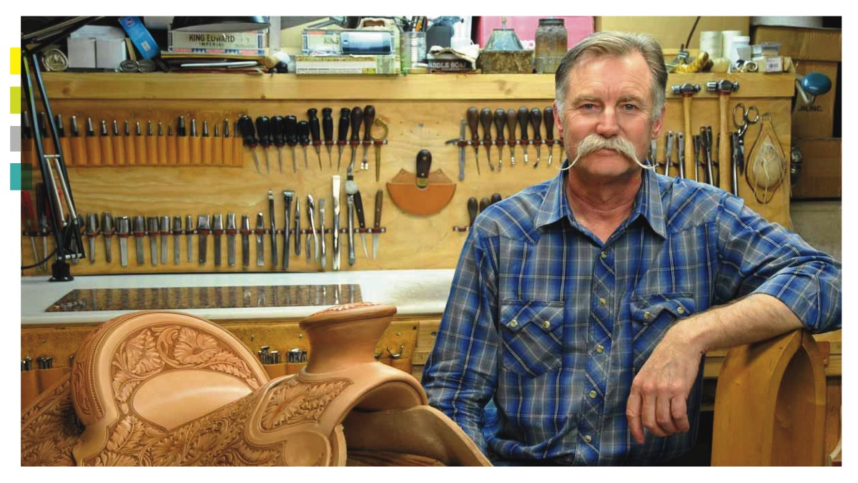
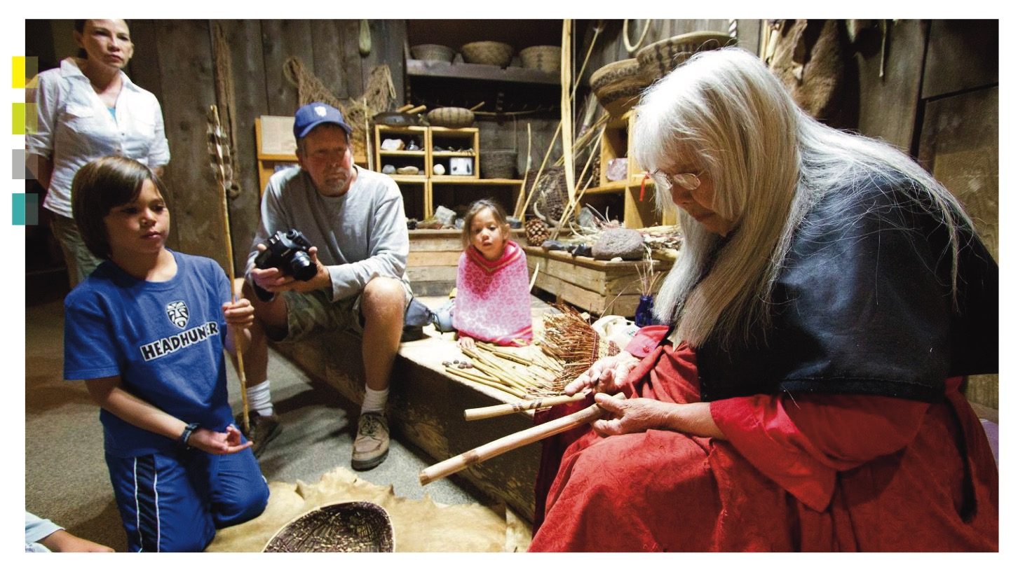
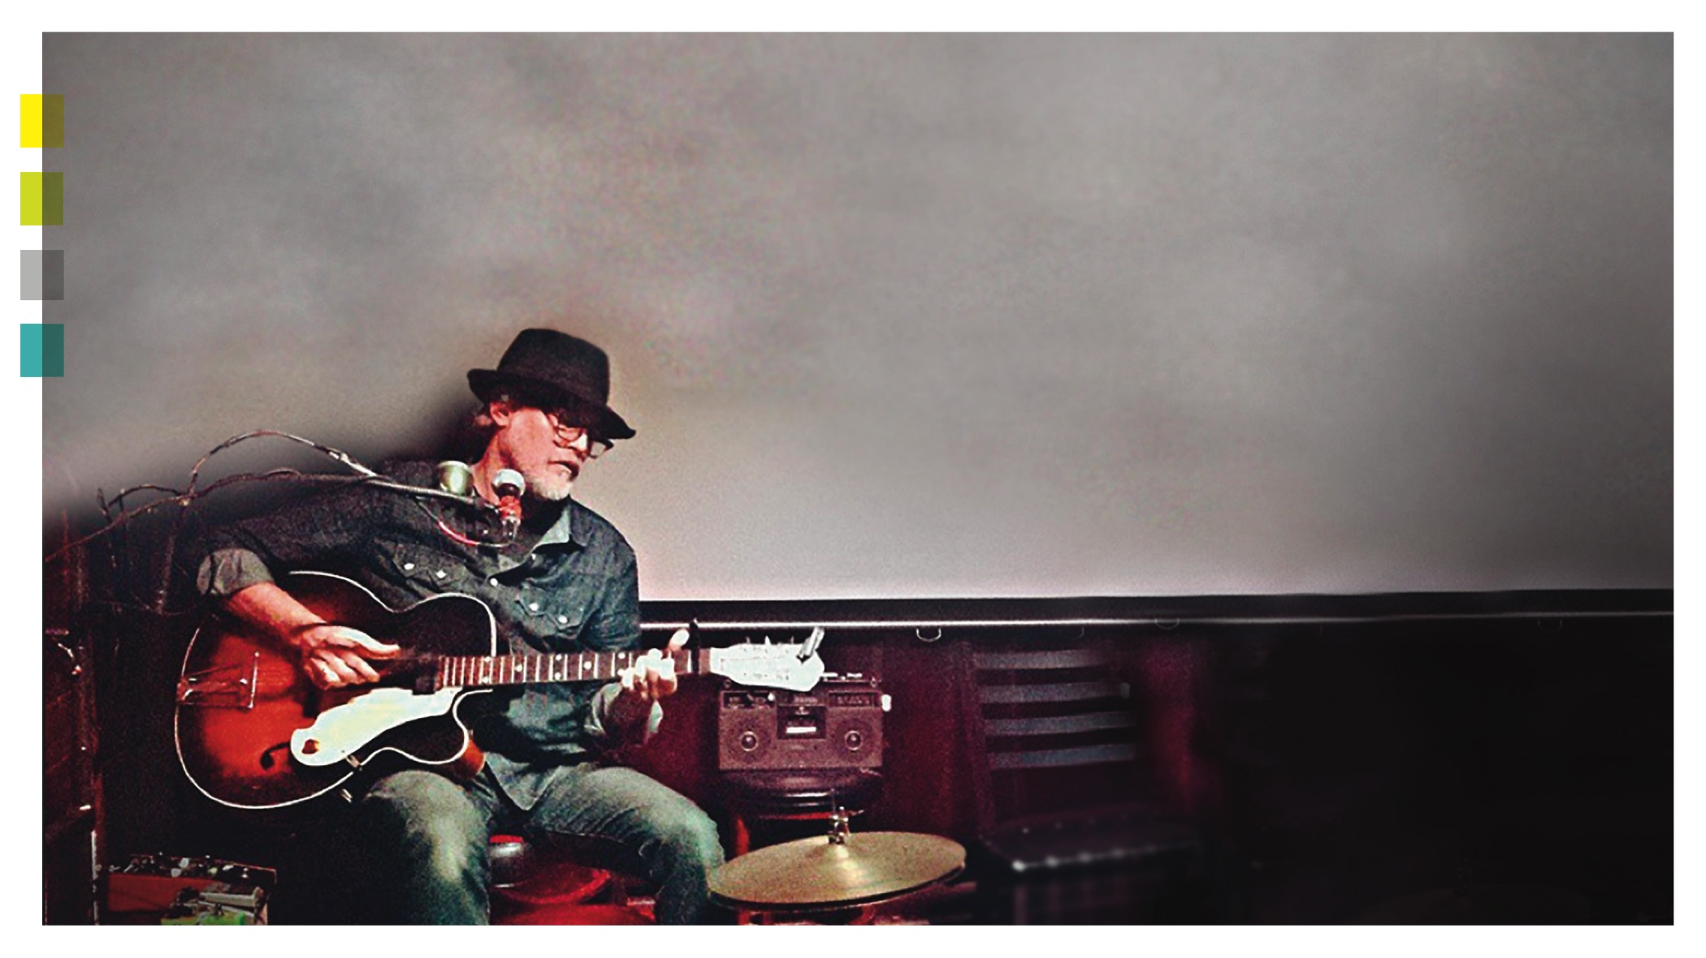
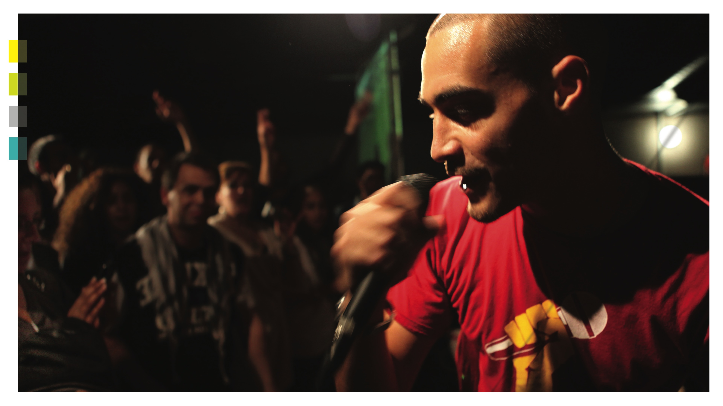
Notes:
But what about this—this is also culture. This is culture. This is culture. This—this—and this: all culture.

Slide 5
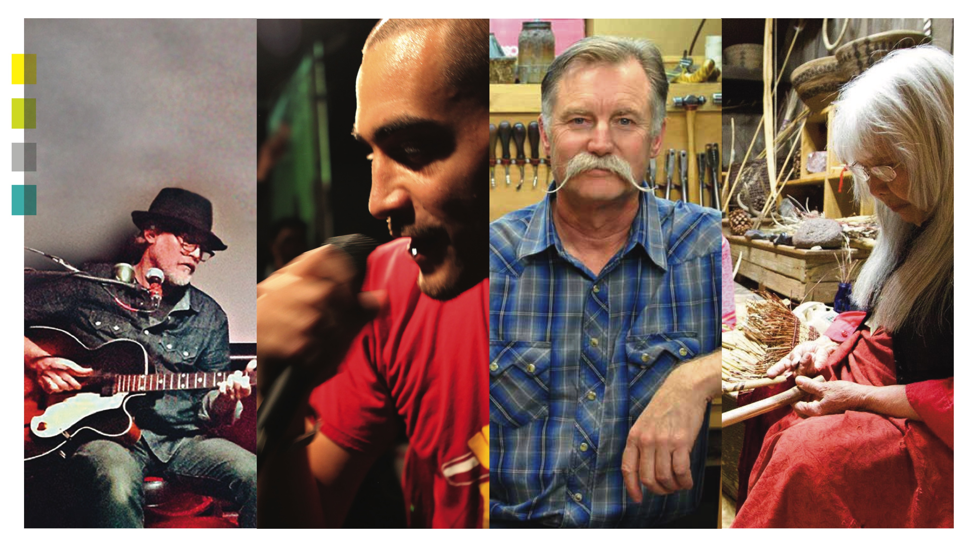
Notes:
In fact in our state, we are blessed with a bounty of experiences that fall under the cultural umbrella: arts, heritage, history and humanities. And taken together, this bounty plays an enormous, very (essential) role in making Oregon, Oregon.

Slide 6
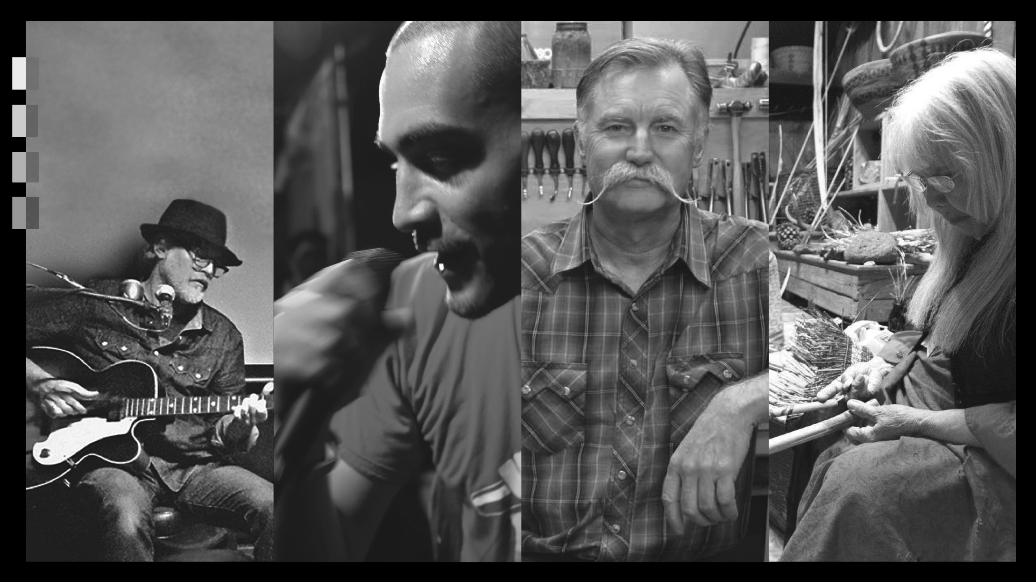
Notes:
But doesn’t culture “just happen?” you ask. For sure, a lot of it was here long before we were. We didn’t create it all. But a lot of our culture can disappear, especially those traditions that aren’t as well known. It can lose its way. It simply can’t be taken for granted that it will thrive forever on its own.

Slide 7
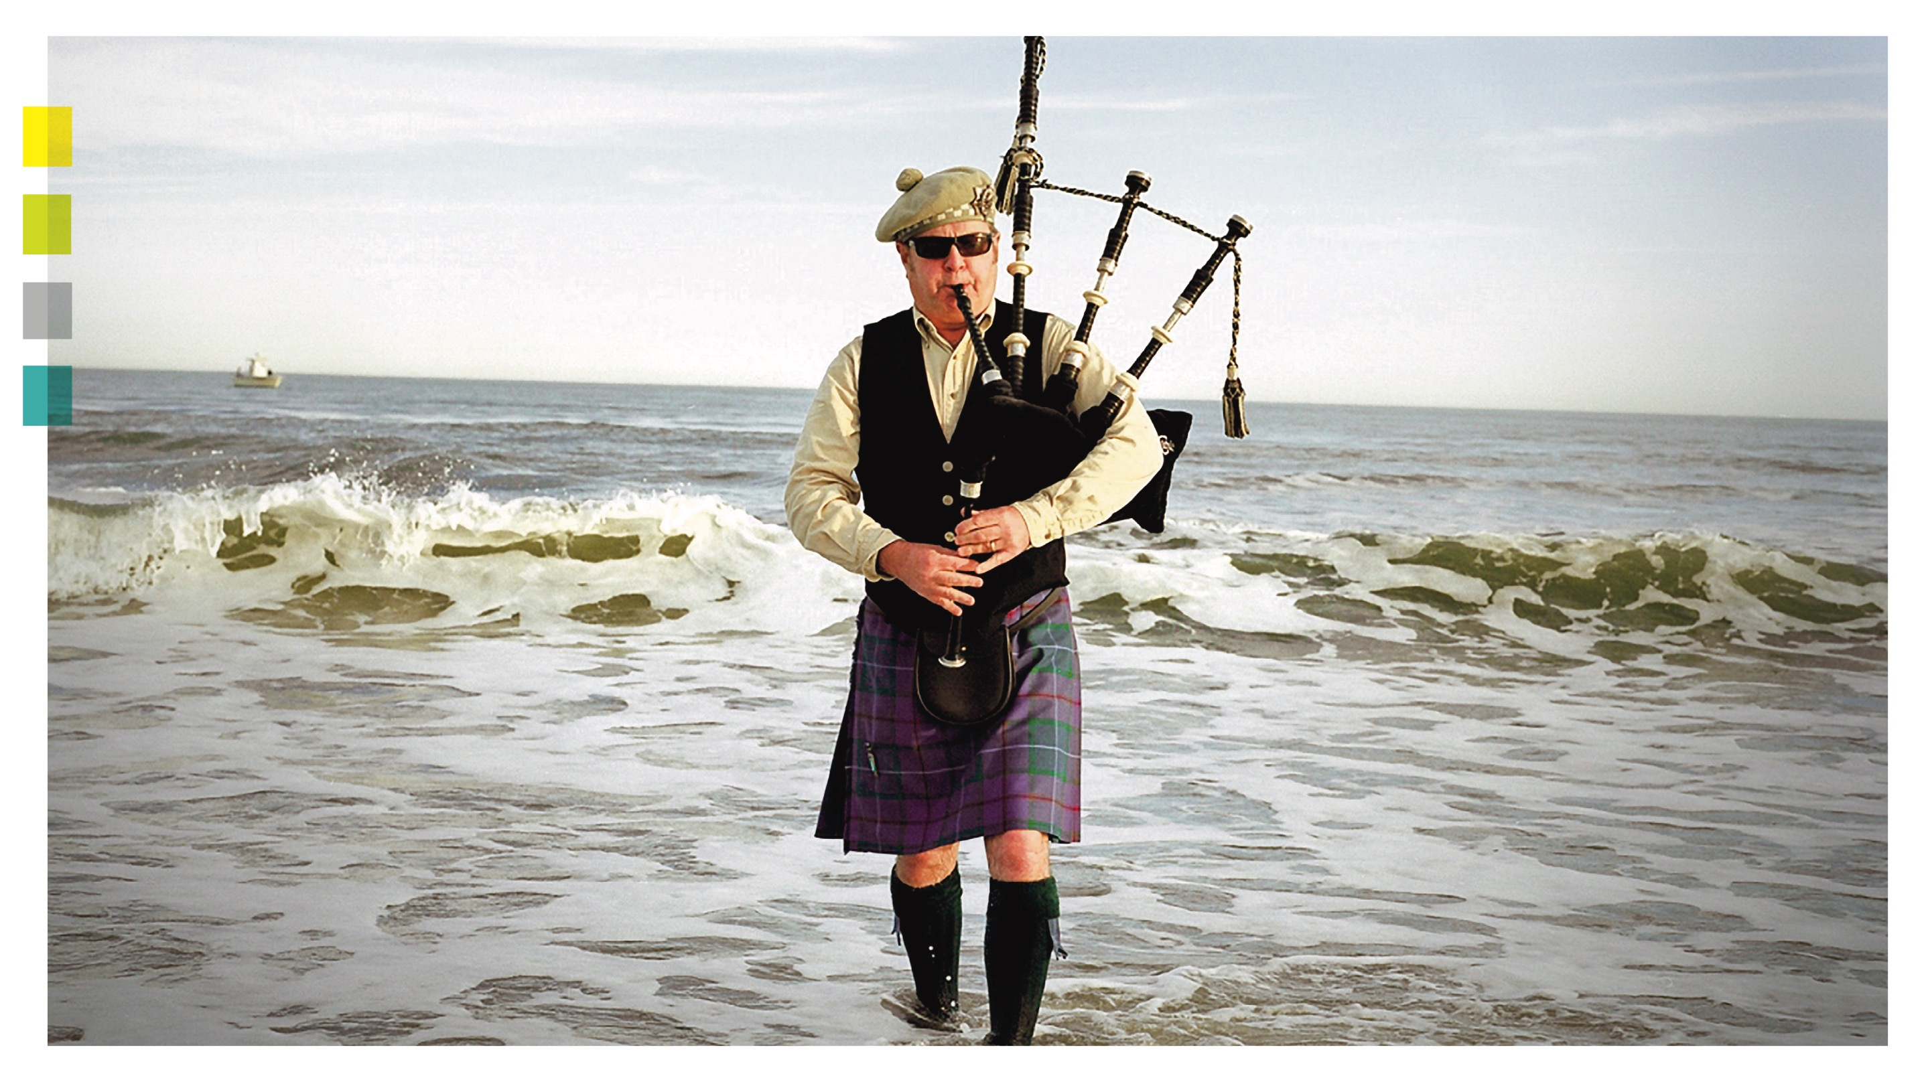
Notes:
We can make sure our culture—in all its many forms— thrives. That Oregon stays the special place that it is. That our special something continues; that it opens new eyes, continually opens new hearts, and makes new connections for our generation and generations to come

Slide 8
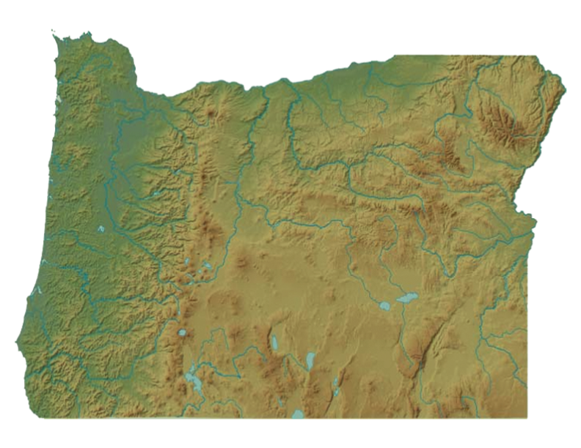
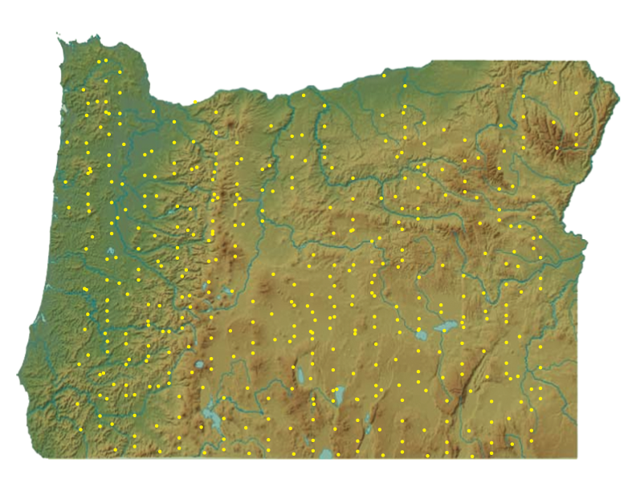
Notes:
This is why the Oregon Culture Trust exists. To put wind in the sails of all kinds of cultural initiatives, big and small, well-known and lesser-known, all across our state. To infuse 1,400 amazing organizations with support so that Oregon never loses its appeal or wonder

Slide 9

Notes:
The way it works is unique, but simple.
Let’s say someone makes their regular donation to a participating nonprofit—that amount is tax deductible.
Now, when they make the same matching contribution to the Trust—that same amount comes back to them as a state tax credit.
Essentially doubling the impact of a donation for free.

Slide 10
MONEY RAISED IN 2015
$4,560,000
Notes:
In 2015, the Cultural Trust raised over $4.56 million. 40% of that goes into a permanent fund, earning interest, ready for future opportunities. The other 60% supports the five state-wide Cultural Partners, 45 county and tribal coalitions, and over 1,400 nonprofits throughout the state. Pretty remarkable.

Slide 11
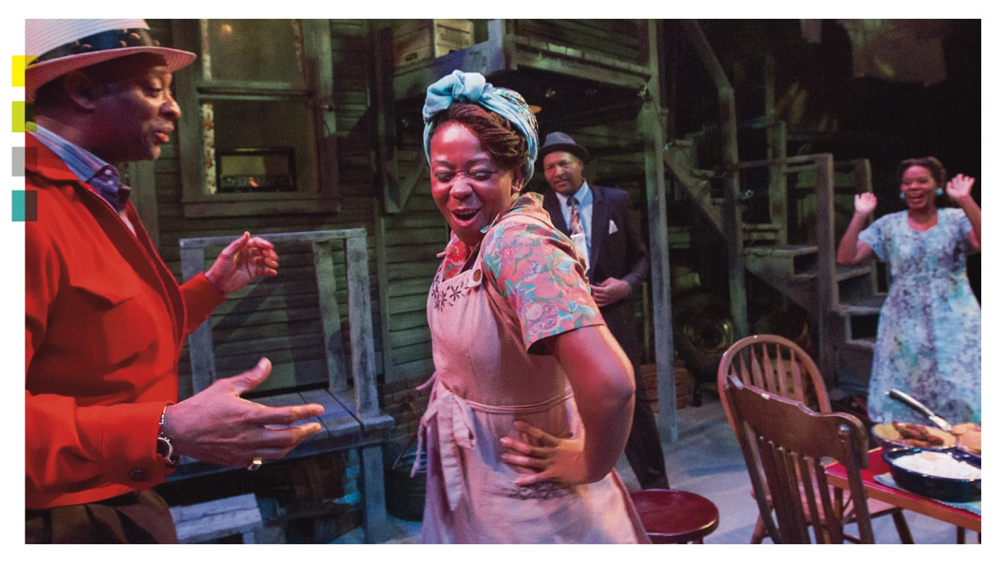

Notes:
Oregon is the only state in the country with a cultural body like this. That tells you something about Oregonians; the value we put on these pursuits. An unparalleled desire to express ourselves. The very things that make Oregon, Oregon.

Slide 12
CULTURALTRUST.ORG
Notes:
If culture— anywhere in Oregon— has ever touched you, we invite you to be part of our 98,000 square miles of yes.
Thank you!

